Slide 1
DATA 403 Final Presentation
Student ID:
Name:

Slide 2
Contents
Introduction
Method
Experiments
Conclusion

Slide 3
Introduction
Describe the information of the environment (MDP information, Properties of environment, What kinds of environment you used? Why you choose? )

Slide 4
Method
Specifically describe the deep learning architecture, training procedure and the techniques applied to improve the performance and stability with including the figure. (Don't bring the picture from website, you should draw it yourself. Using the tool draw.io is recommended)
Deep Learning Architecture
Describe the neural network architecture you used (e.g. MLP, CNN, RNN, Transformer, ResNet, etc.).
Additional RL Technique (Optional)
Describe the contents of used techniques. (e.g, environment wrapper, reward normalization, etc.)

Slide 5
Experiments
Experimental setting
Describe the experimental conditions (e.g. Hyperparameter setting, Device setting)
Performance
Conduct a performance evaluation of your PPO algorithm in two environments. The results should be shown using the figure or table)
Hyperparameter experiment (optional)
If the experiment was conducted by changing the values for various hyperparameters (e.g., the number of layers in the deep learning model, architecture, the number of filters, the learning rate, and the discount factor, gae labmda), show the results of the experiment and analyze them.

Slide 6
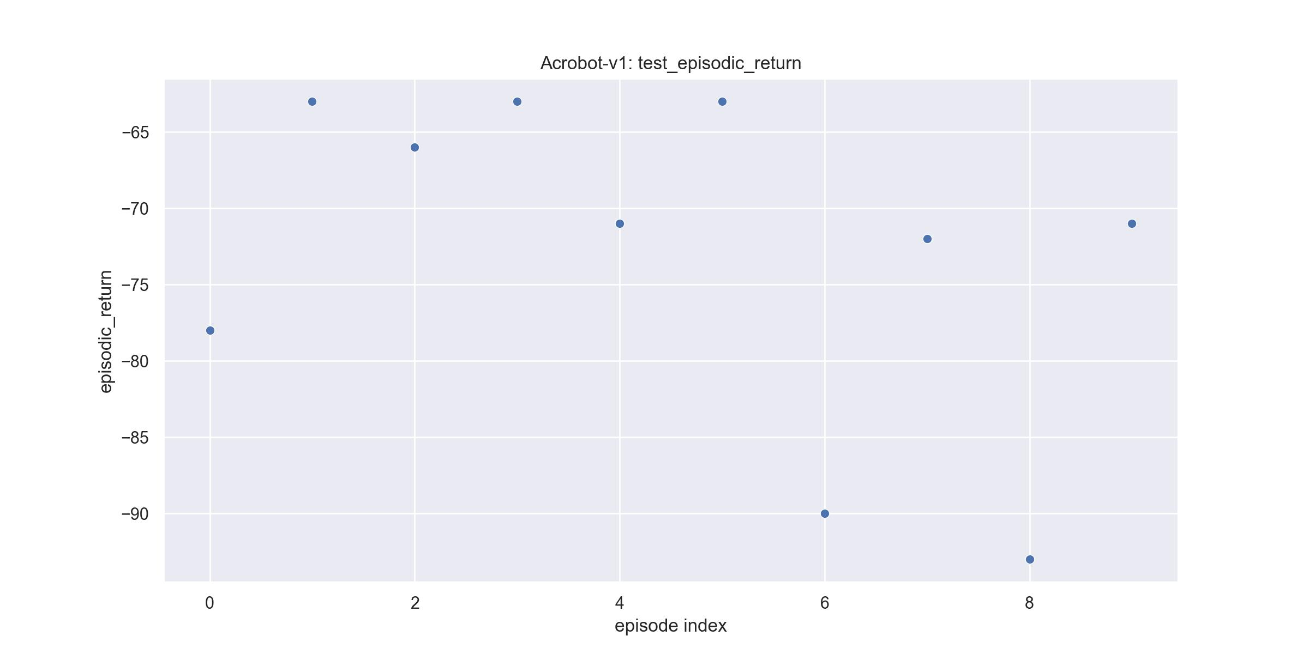
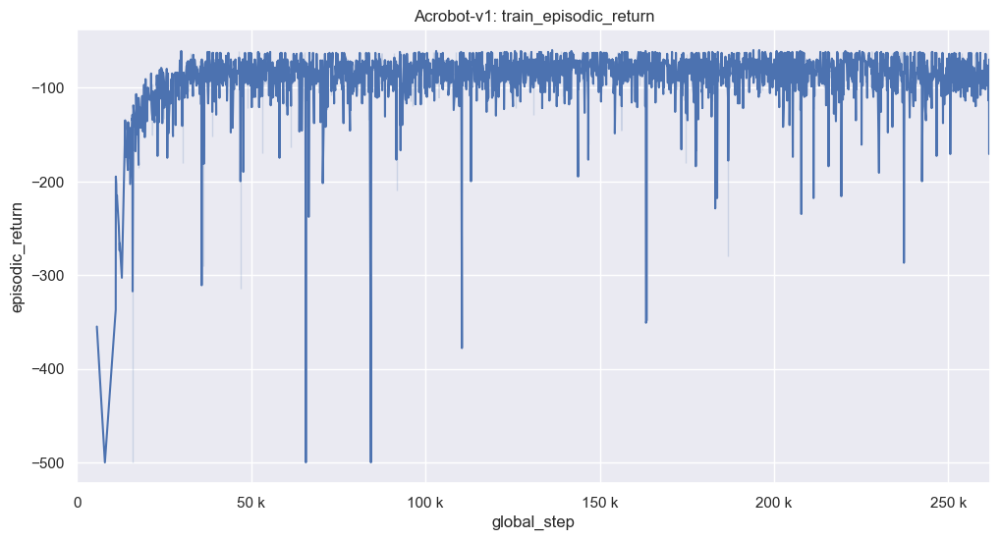
Experiments
Example pictures

Slide 7
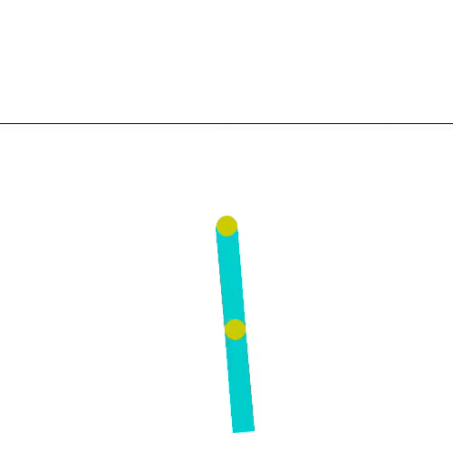
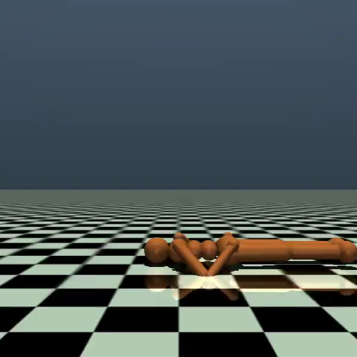
Experiments
Example videos of trained agent (within 10 seconds)

Slide 8
Conclusion
Analysis of the experiments
Describe your analysis of experiments. (Why the agent works well/badly on the selected algorithm?, What is the most important things for training agents?, Why PPO is more efficient?)
Conclude and summarize your training procedure and results

